Slide 1
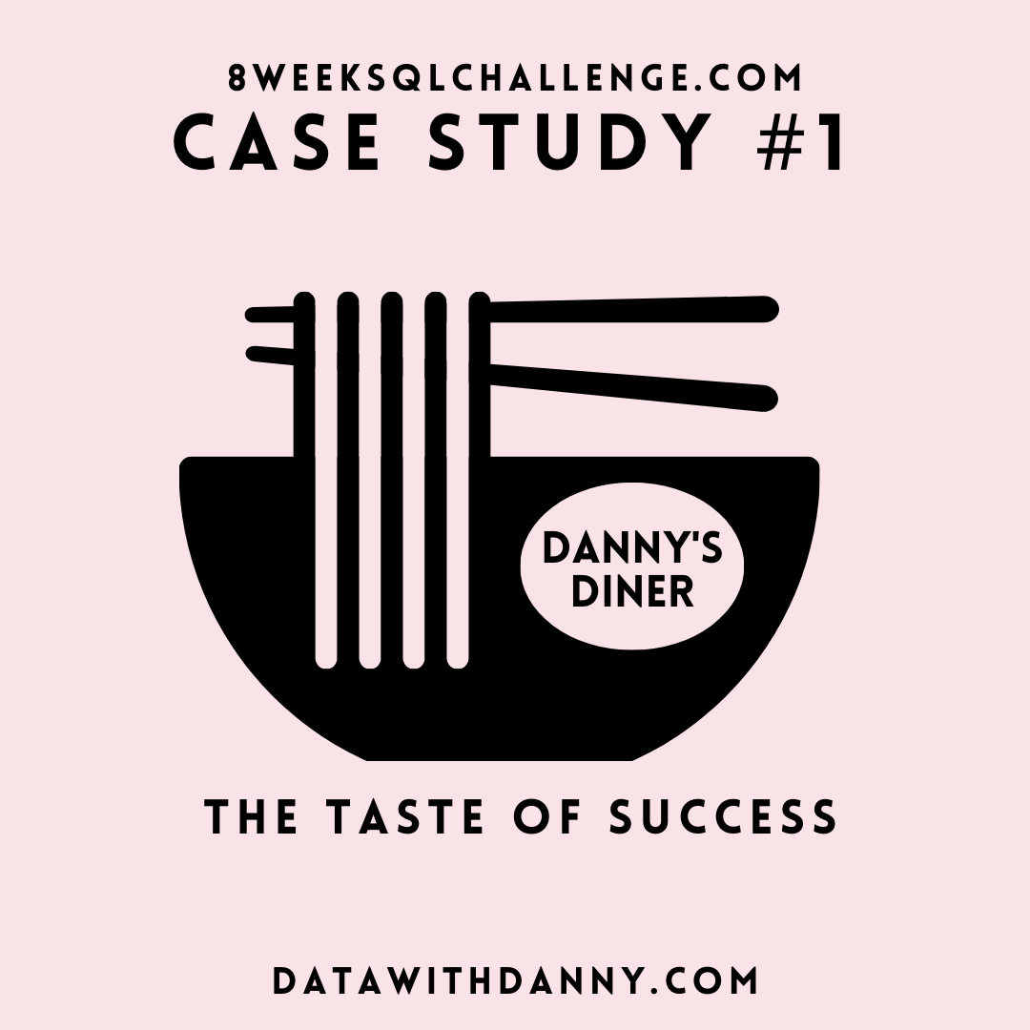
Case Study #1 - Danny's Diner

Slide 2
Introduction
Danny seriously loves Japanese food so in the beginning of 2021, he decides to embark upon a risky venture and opens up a cute little restaurant that sells his 3 favorite foods: sushi, curry and ramen.
Danny’s Diner is in need of your assistance to help the restaurant stay afloat - the restaurant has captured some very basic data from their few months of operation but have no idea how to use their data to help them run the business.

Slide 3
Problem Statement
Danny wants to use the data to answer a few simple questions about his customers, especially about their visiting patterns, how much money they’ve spent and also which menu items are their favorite. Having this deeper connection with his customers will help him deliver a better and more personalized experience for his loyal customers.
He plans on using these insights to help him decide whether he should expand the existing customer loyalty program - additionally he needs help to generate some basic datasets so his team can easily inspect the data without needing to use SQL.
Danny has provided you with a sample of his overall customer data due to privacy issues - but he hopes that these examples are enough for you to write fully functioning SQL queries to help him answer his questions!
Danny has shared with you 3 key datasets for this case study:
sales
menu
members

Slide 4
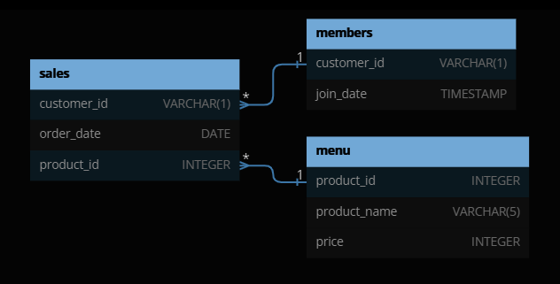
Entity Relationship Diagram

Slide 5
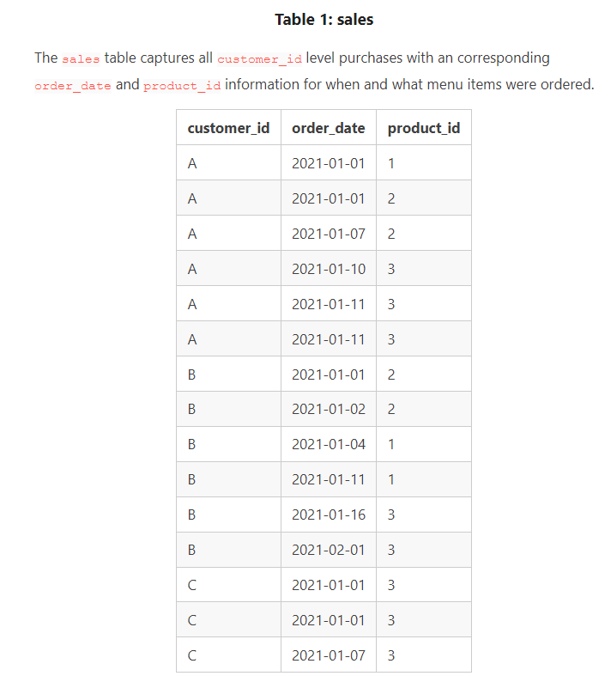
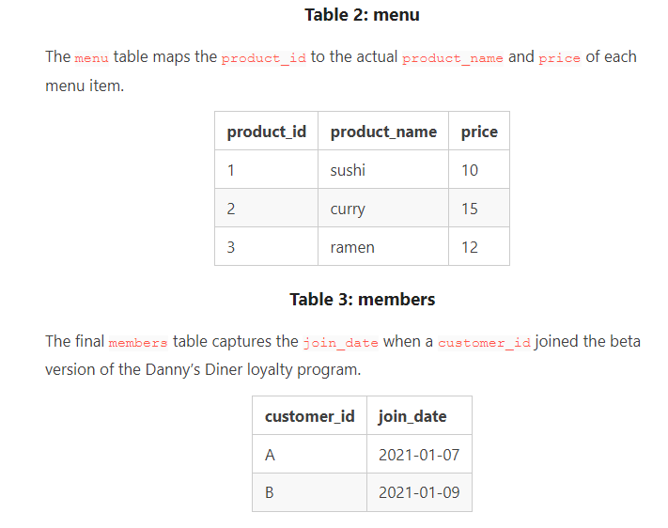
Tables

Slide 6
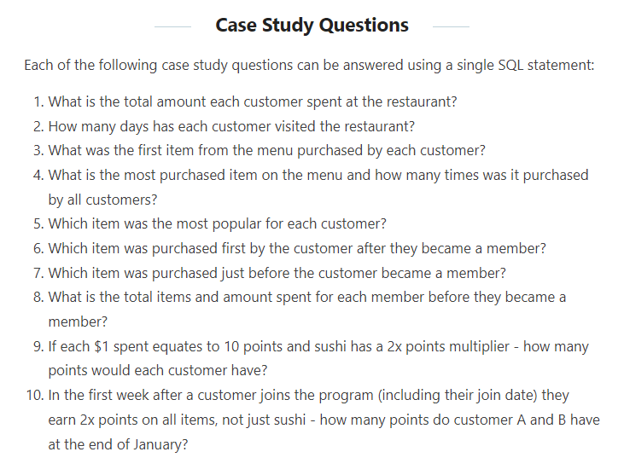

Slide 7
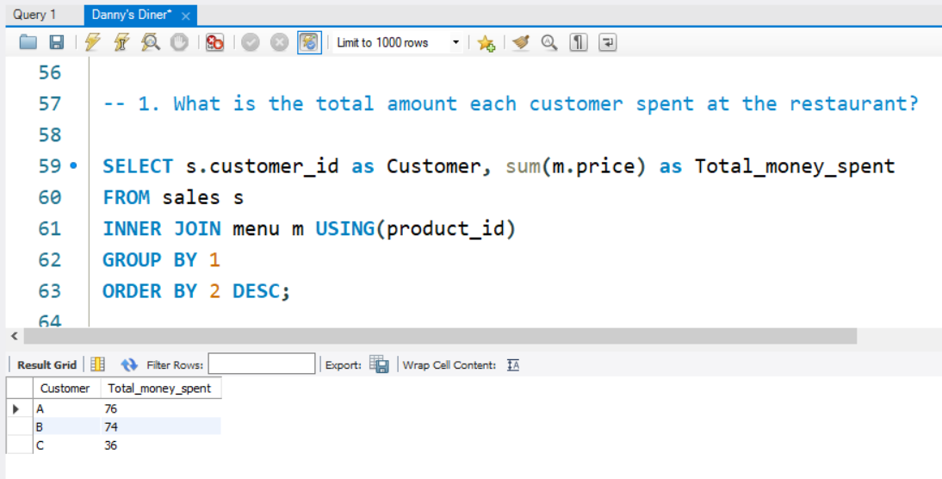
Q1. What is the total amount each customer spent at the restaurant?

Slide 8
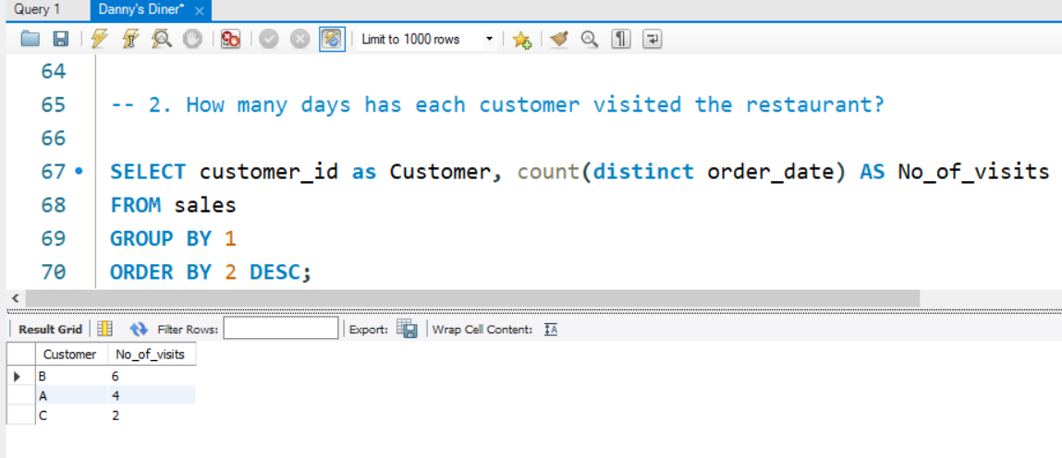
Q2. How many days has each customer visited the restaurant?

Slide 9
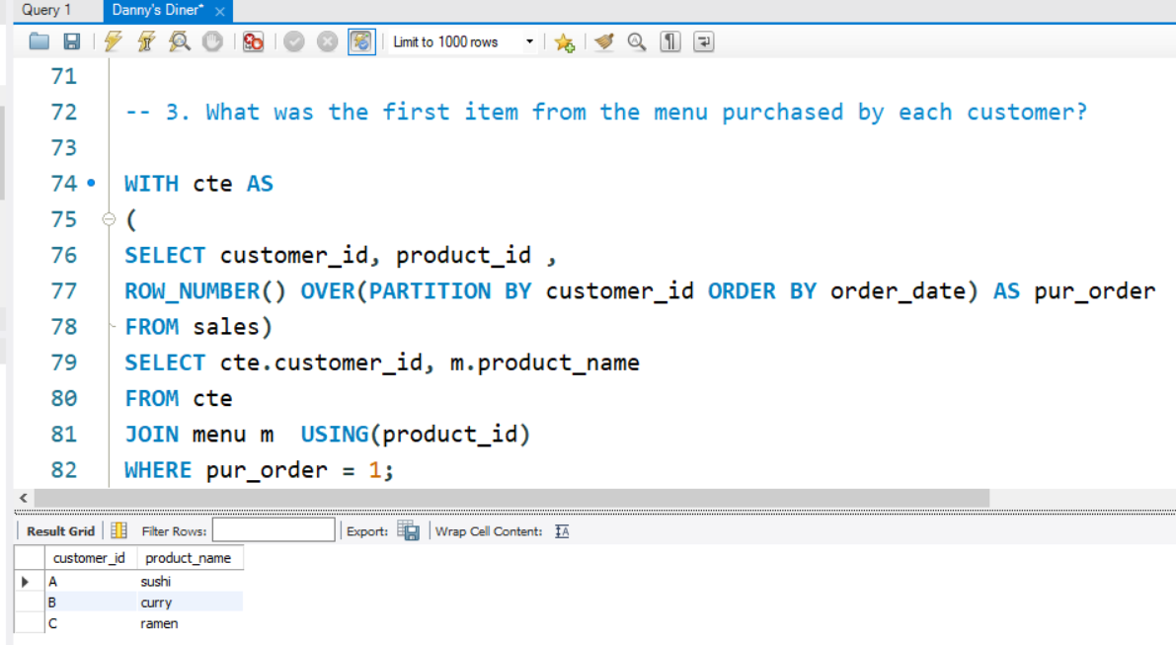
Q3. What was the first item from the menu purchased by each customer?

Slide 10
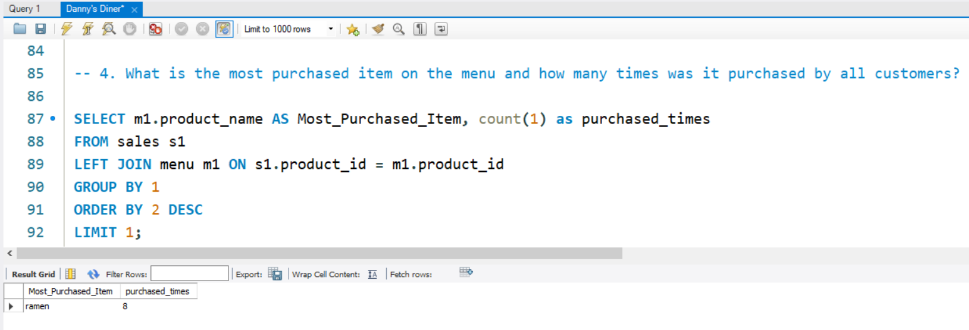
Q4. What is the most purchased item on the menu and how many times was it purchased by all customers?

Slide 11
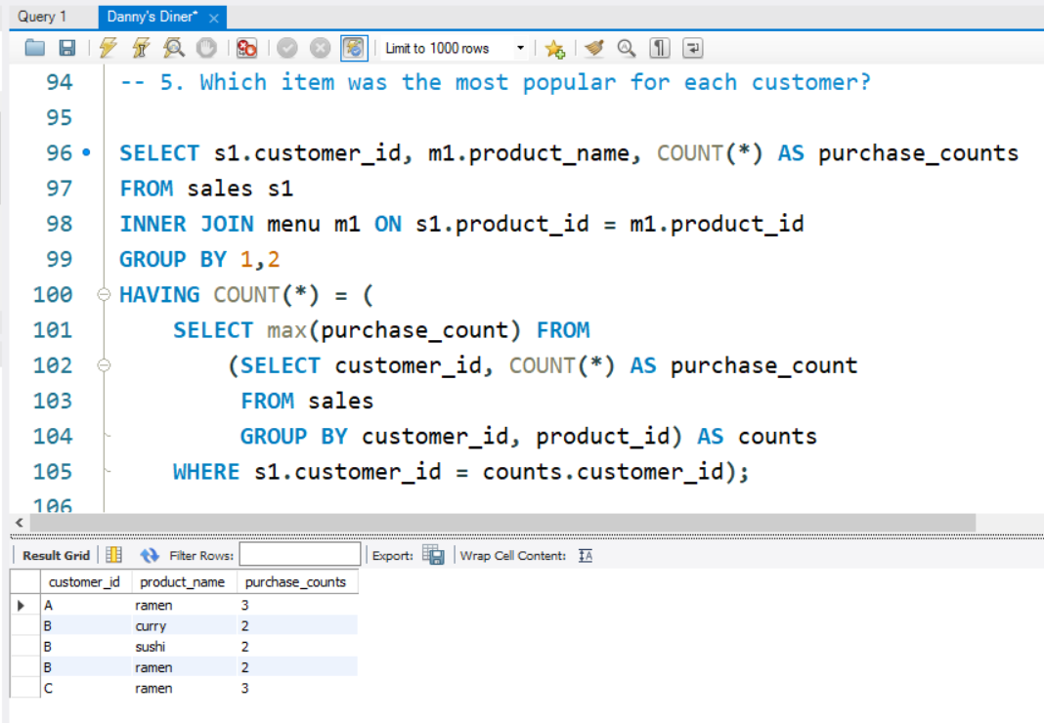
Q5. Which item was the most popular for each customer?

Slide 12
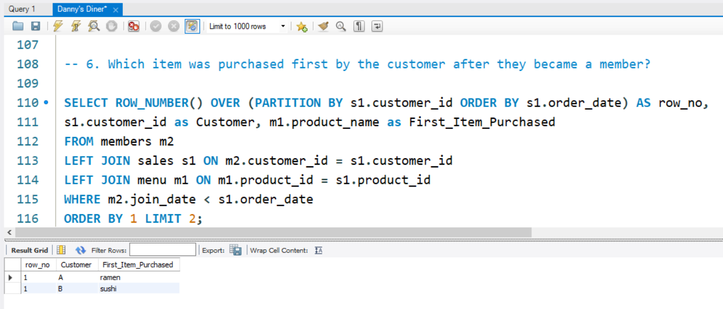
Q6. Which item was purchased first by the customer after they became a member?

Slide 13
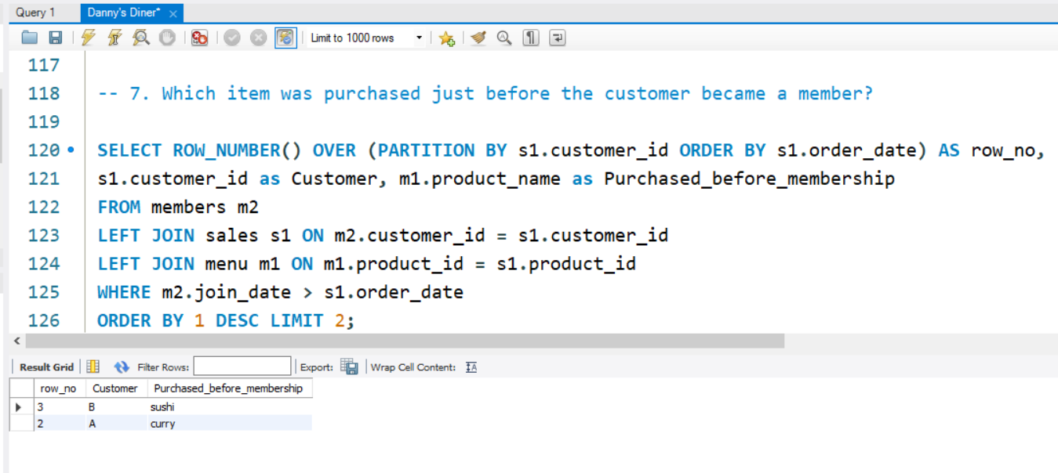
Q7. Which item was purchased just before the customer became a member?

Slide 14
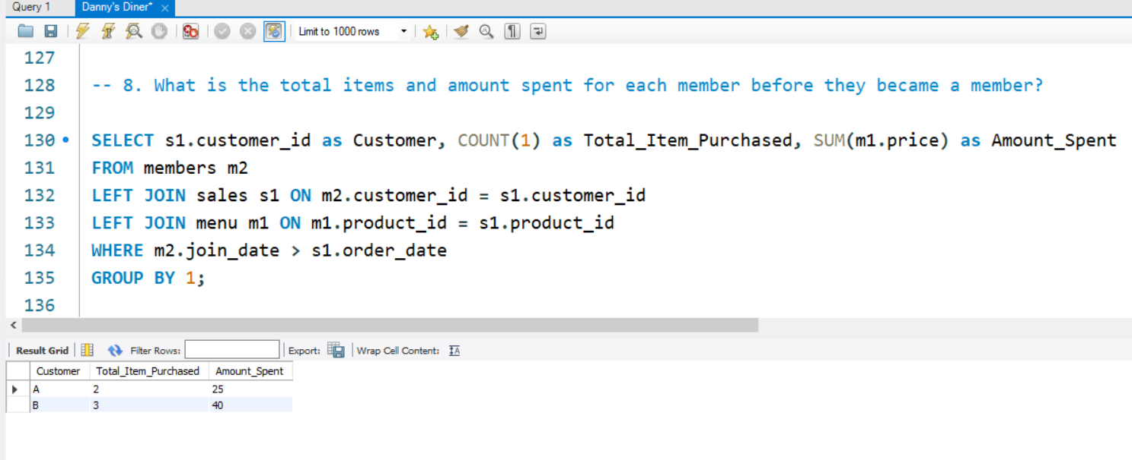
Q8. What is the total items and amount spent for each member before they became a member?

Slide 15
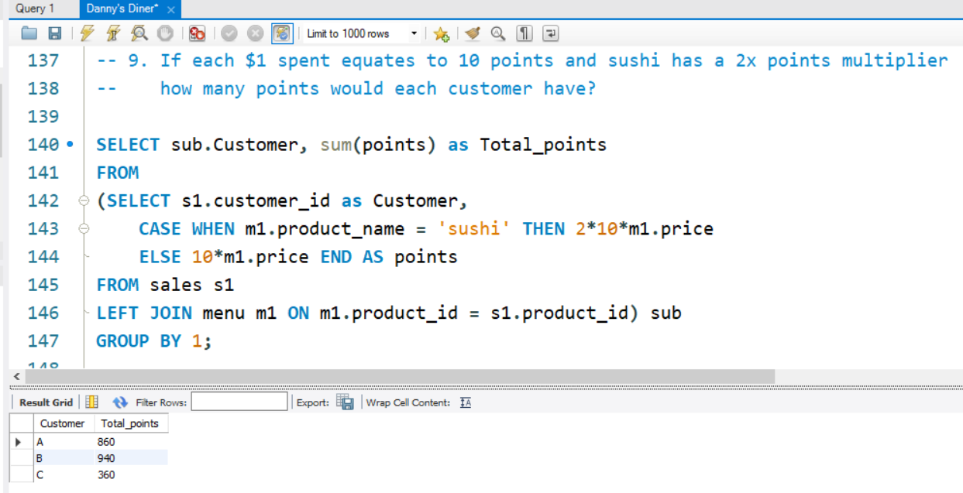
Q9. If each $1 spent equates to 10 points and sushi has a 2x points multiplier - how many points would each customer have?

Slide 16
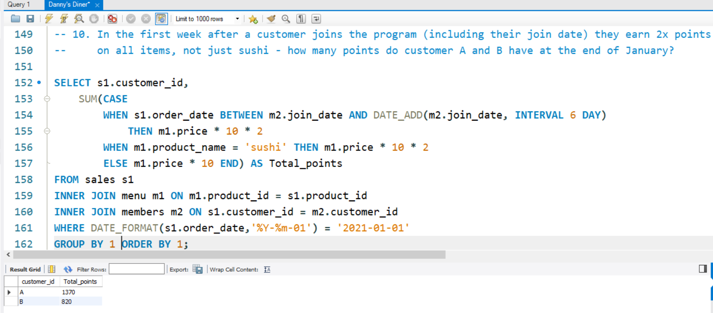
Q10. In the first week after a customer joins the program (including their join date) they earn 2x points on all items, not just sushi - how many points do customer A and B have at the end of January?

Slide 17
Key Insights
Customer A spent maximum amount i.e. $76.
The most purchased item is Ramen.
Customer B is most frequent customer.
Not all customer who came to the restaurant becomes member of the restaurant so the conversion rate is 66.66%.

Slide 18



Thank you
Shivam Panwar

